Slide 1
The LCW
Eames Lounge Wood Chair

Slide 2
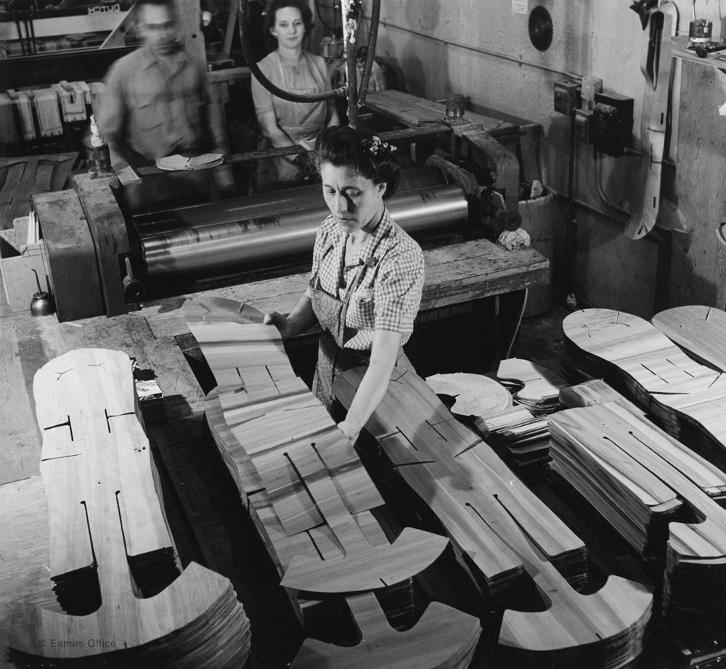
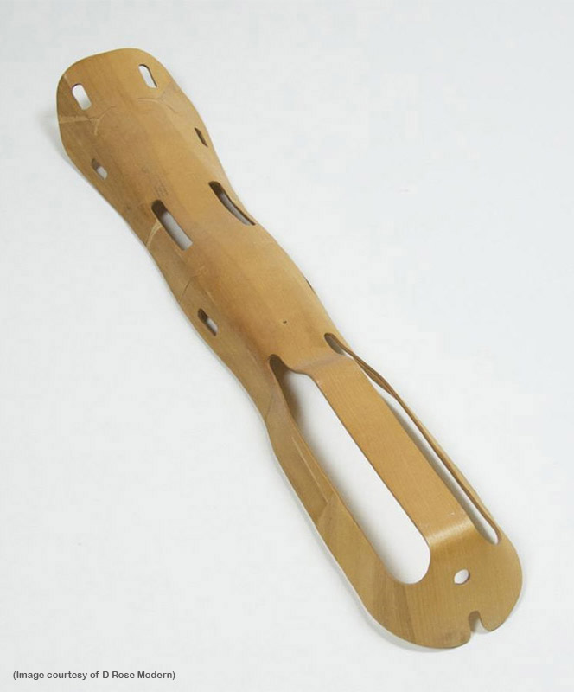
Notes:
Before the production of the chair, Charles and Ray Eames, work of Wartime Leg Splints in WWII. Molded plywood which could be reproduced for cheap at a fast rate. Lightweight and contoured for the human form.

Slide 3
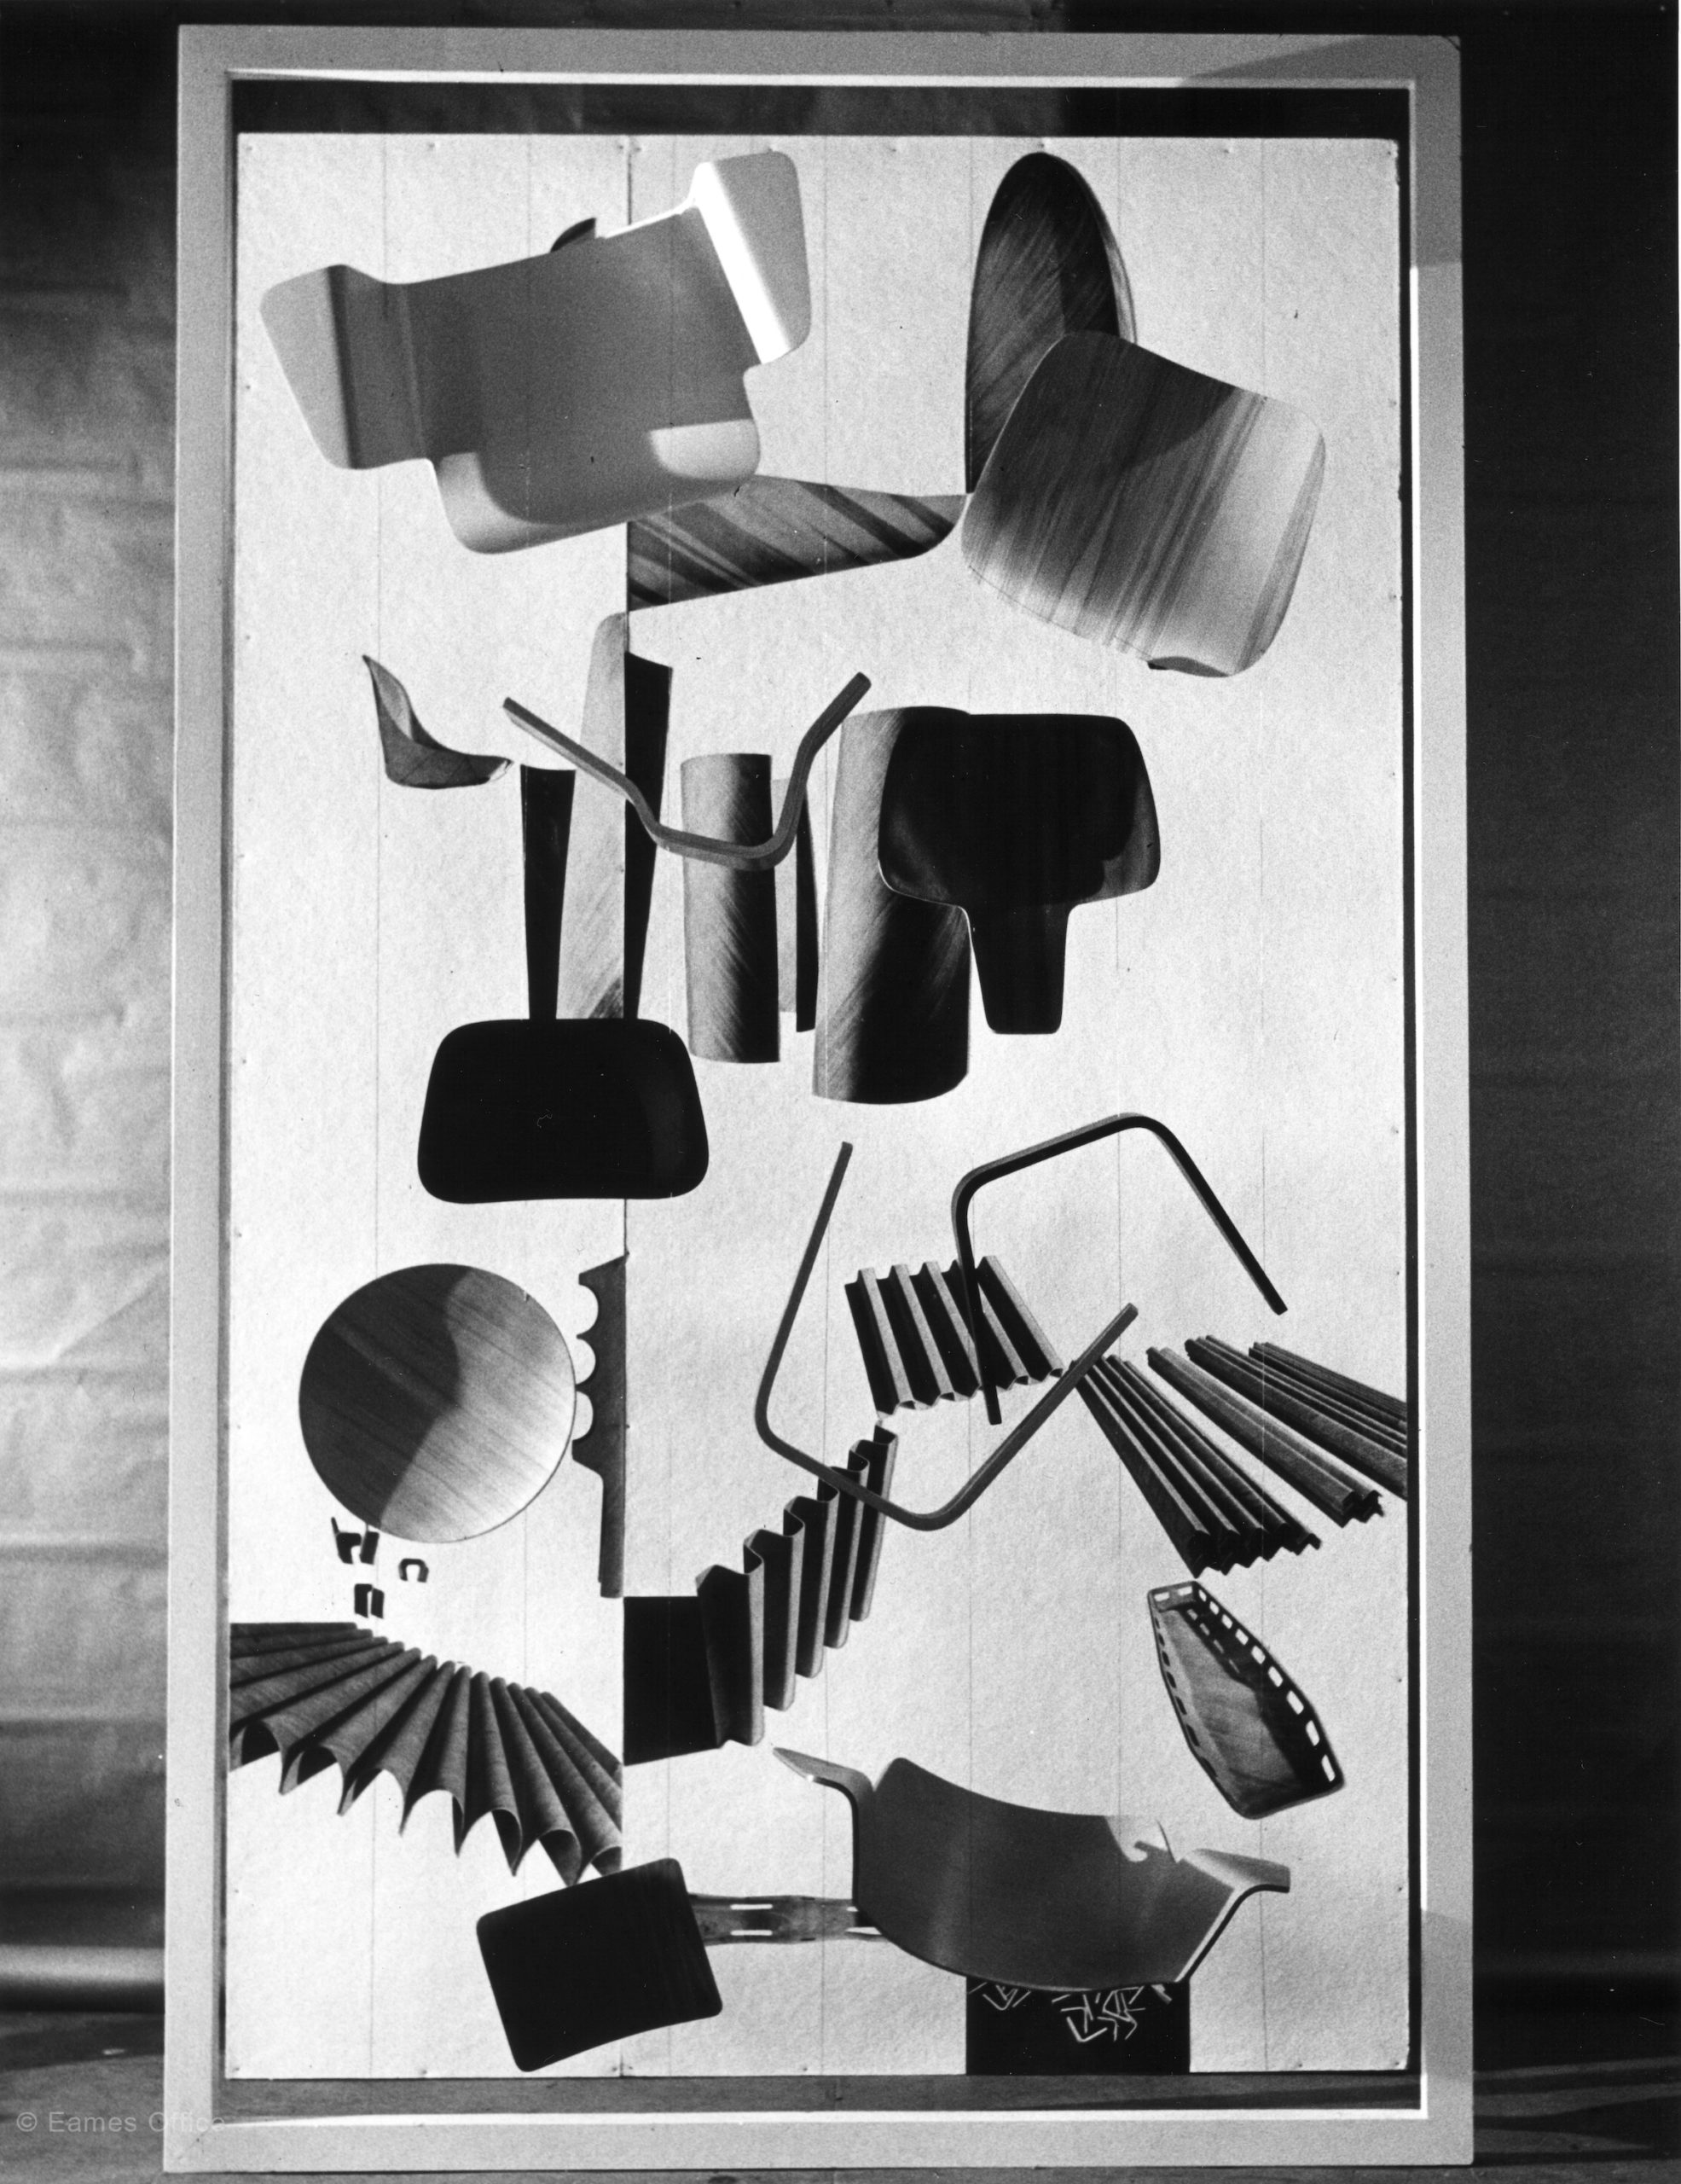
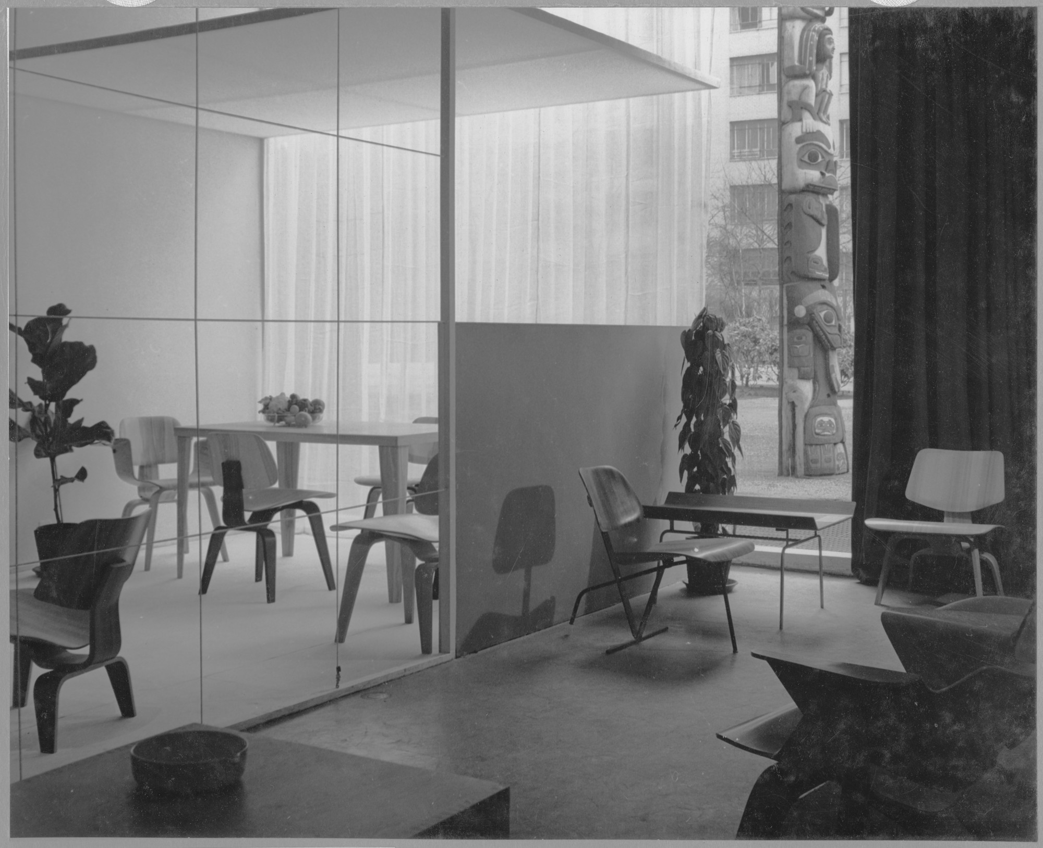
Notes:
The turn to furniture in 1946 after the war. This was a showcase of the chair at a MOMA exhibition. Showcased cutting edge ideas and designs. A chair that creates perfect curves and proportions and is put together in only two parts. An honest use of form and production.

Slide 4
“to get the most of the best to the greatest number of people for the least.”
Notes:
Describes both their mentality and their process of producing a chair.

Slide 5
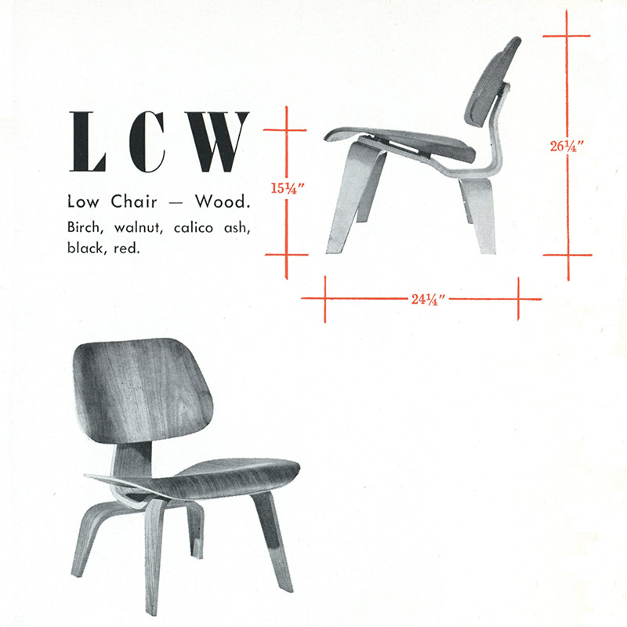
Notes:
Chair itself and dimensions. Typographic ideas and possibly additional textual info.

Slide 6
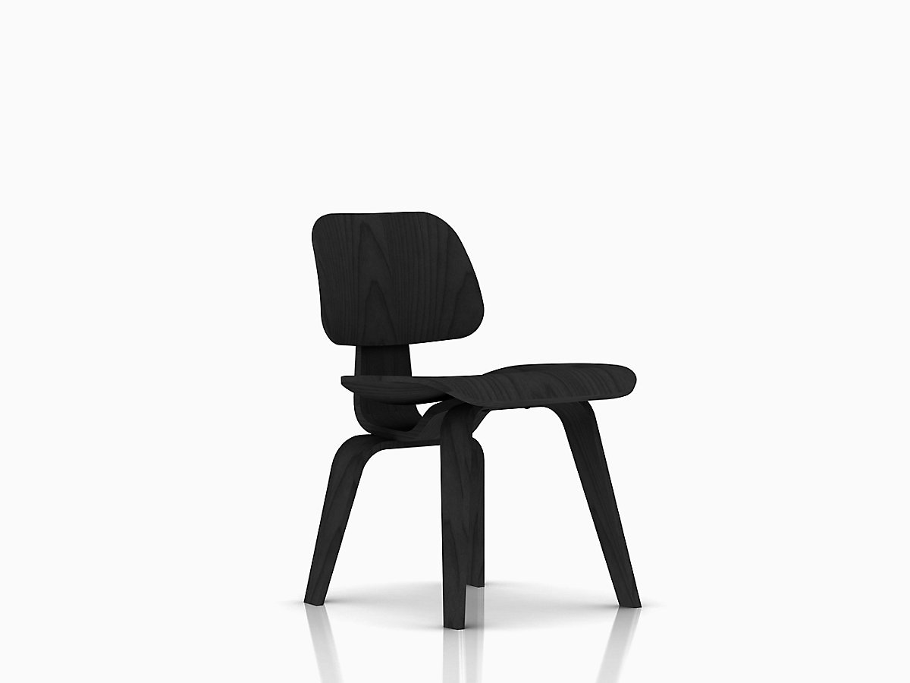
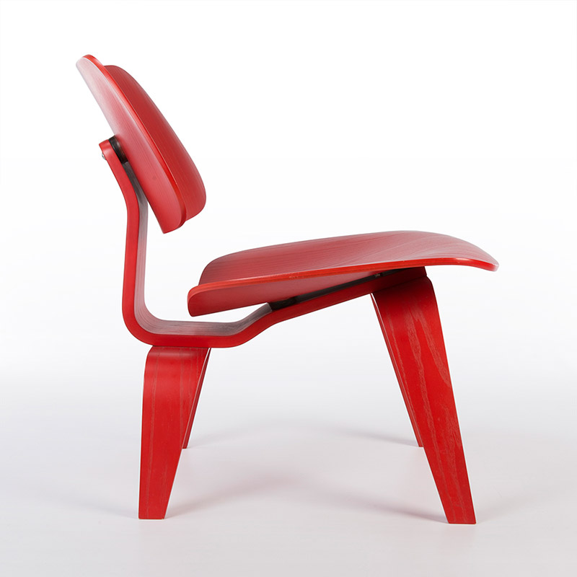
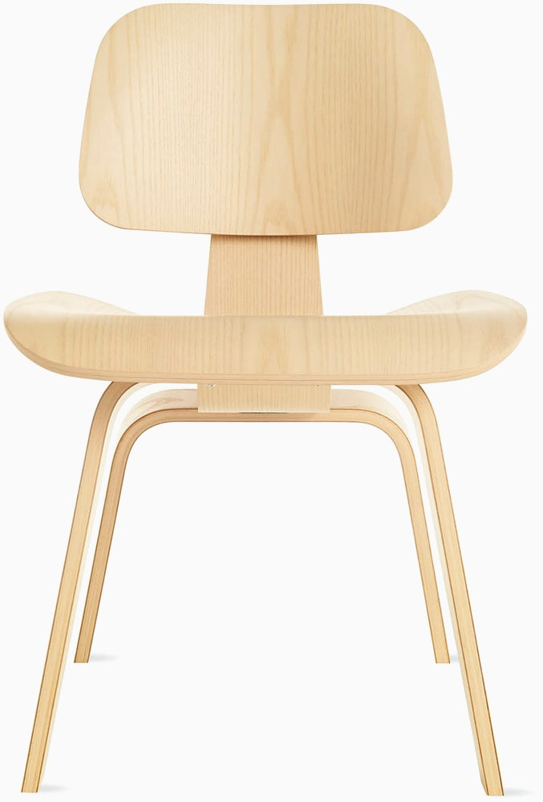

Slide 7
Form–
Organic
Contour
Mold
Elegant
Construction–
Layered plywood
Two parts
Cutting edge
*Flexible & Solid
Mentality–
Honest
Cheap/Fast
Modern/Classic
Perfection

